Slide 1
Are You Sleepless in Seattle or Just Sleepy?
David C Chang, MD
Board Certified, American Academy of Sleep Medicine

Slide 2
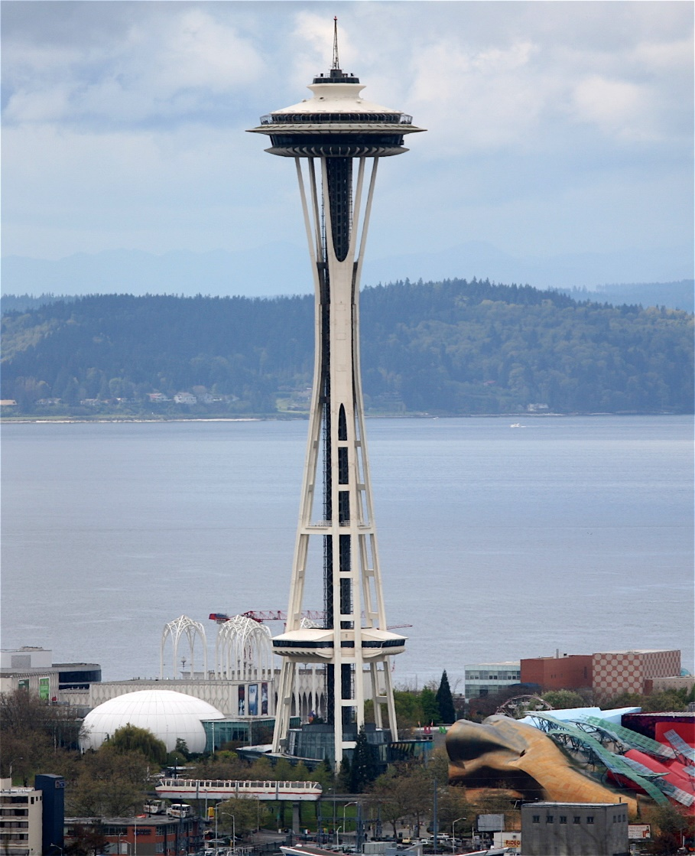
Topics for Today
Sleep Architecture
Sleep As We Get Older
Restless Leg Syndrome
Jet Lag
Sleep Apnea
Insomnia
Size of this preview: 464 × 600 pixels

Slide 3
What Does Sleep Do?
Restorative theory –
Regeneration of body functions
Metabolic theory –
Regulation of body temp/energy conservation
Survival theory –
Protective/adaptive behavior or immune defense

Slide 4
What Does Sleep Do?
Neural growth/processing theory
Brain development/ restoration/ learning/ memory (Physical Chemistry final exam at Harvard)
Somatic growth theory –
Growth hormone release during NREM sleep

Slide 5
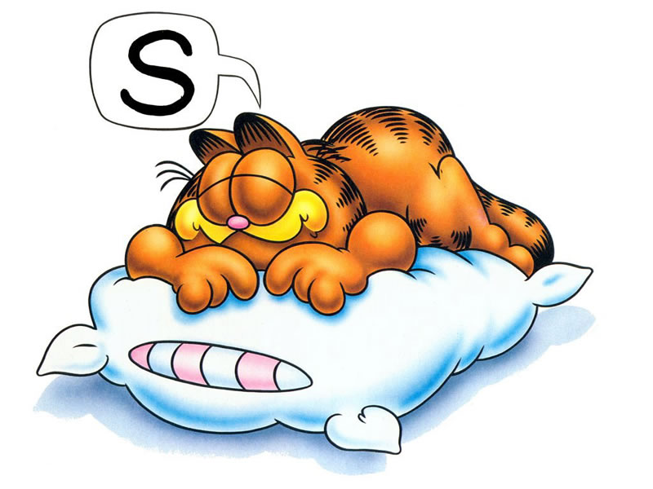
Sleep
All mammals require sleep
REM Sleep
NREM Sleep
Stage 1 and 2
Stage 3 and 4 (deep sleep)

Slide 6
Stages of Sleep
NREM Sleep (75% of night as adults)
Stage 1 –
light sleep
between awake/sleep

Slide 7
Stages of Sleep
NREM Sleep
Stage 2 –
onset of sleep
disengaged with environment
breathing/heart rate are regular
body temperature gradually decreased throughout night

Slide 8
Stages of Sleep
NREM Sleep
Stage 3&4 –
deep & restorative sleep
low blood pressure
slower breathing

Slide 9
Stages of Sleep
REM Sleep (25% of night as adults)
Every 90 minutes throughout sleep
Dreams occur during REM sleep
Body is immobile and relaxed
Irregular breathing and heart rate
Important in daytime performance and may contribute to memory consolidation

Slide 10
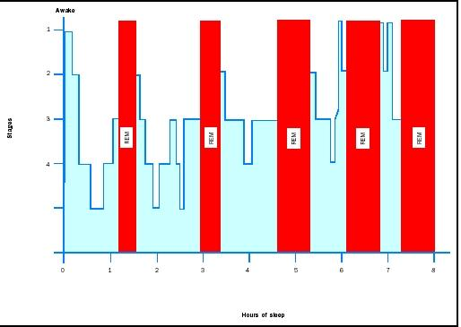
Sleep Architecture During the Night
Stage
Sleep Hours

Slide 11
Sleep Hours
Infants/Babies*
0-2 mons: 10.5-18.5 hours
2-12 mons: 14-15 hours
Toddlers/Children*
12-18 mons: 13-15 hours
18mons-3yrs: 12-14 hours
3-5 yrs: 11-13 hours
5-12 yrs: 9-11 hours *includes naps

Slide 12
Sleep Hours
Adolescents:
8.5-9.5 hours
Adults:
7-9 hours

Slide 13
1935 2024

Slide 14
1935 2024 Average Hours a Night of Sleep
9 hours 7 hours

Slide 15
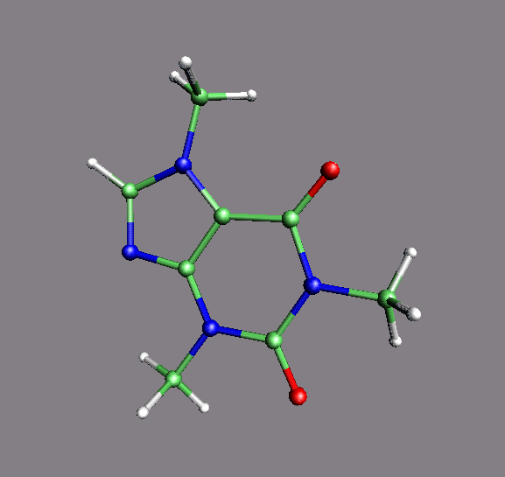
Caffeine
Most widely used stimulant worldwide
Found in coffee, tea and chocolate

Slide 16
Common Beverages
Red Bull (8.2 oz) 80 mg
Mountain Dew 55 mg
Diet Coke 45.6 mg
Drip Coffee 115-175 mg
Brewed Coffee 80-135 mg
Espresso (2 oz) 100 mg
Instant Coffee 65-100 mg

Slide 17
Common Beverages
Green Tea 15 mg
Hot coco 14 mg
Tea 40-60 mg
Decaf Coffee 2-4 mg
Chocolate bar (8 oz) 8 mg
Ensure plus, chocolate (8 oz) 10 mg

Slide 18
Caffeine
Half-life of caffeine is 3-7 hours
The effects may last as long as 8-14 hours
Can lead to significant effects on nighttime sleep
If possible, avoid caffeinated beverages late in the day

Slide 19
Sleep As We Get Older
Less time spent in deep sleep (stage 3 and 4 sleep)
Less secretion of melatonin (produced in pineal gland) and growth hormone secretion which help maintain sleep/wake cycle
Decrease natural light exposure
More fragmented sleep

Slide 20
Sleep As We Get Older
Other medical conditions cause poor sleep:
Arthritis COPD
Heartburn Heart failure
Parkinson's Disease Osteoporosis
Alzheimer's Disease Cancer
GERD Pain
Menopause Incontinence

Slide 21
Parkinson’s Disease
Chronic, progressive neurodegenerative disorder
characterized by some cardinal signs:
Rest tremor
Rigidity
Bradykinesia
Gait disturbance.

Slide 22
Parkinson’s Disease
REM Behavior Disorder
Loss of physiologic skeletal muscle paralysis during REM sleep in association with excessive motor activity while dreaming
Often presents with disruption of the bedroom partner’s sleep

Slide 23
Parkinson’s Disease
REM Behavior Disorder can be associated with Parkinson’s Disease or Multiple System Atrophy
Can be treated with medication

Slide 24
Acute REM Behavior Disorder
Can occur during withdrawal from alcohol or sedative-hypnotics
Can occur with tricyclics antidepressants
SSRIs (Paxil, Zoloft, Prozac, etc)
Venlafaxine (Effexor)

Slide 25
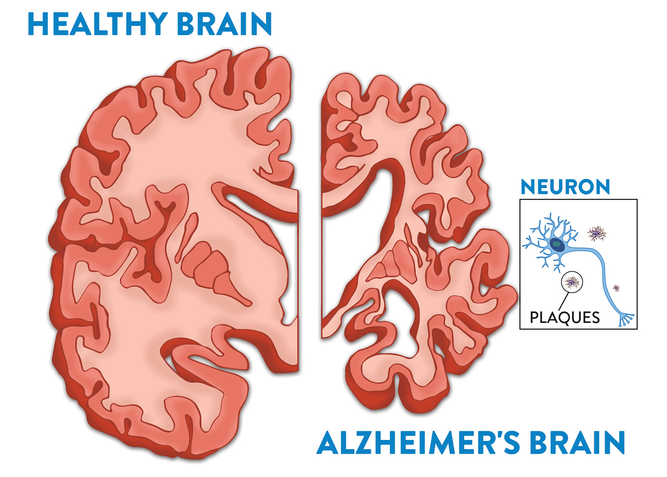
Alzheimer’s Disease
Most common type of dementia
Degenerative disease of the brain
Estimated that 50 million people worldwide were afflicted by AD in 2020

Slide 26
Alzheimer’s Disease
Circadian rhythm dysregulation
Due to DECREASD production of melatonin, growth hormone, TSH, cortisol, estradiol, testosterone
Leads to irregular sleep/wake schedule

Slide 27
Alzheimer’s Disease
Common cause of nursing home placement due to circadian rhythm change
Maintain regular schedule
Bright light in morning

Slide 28
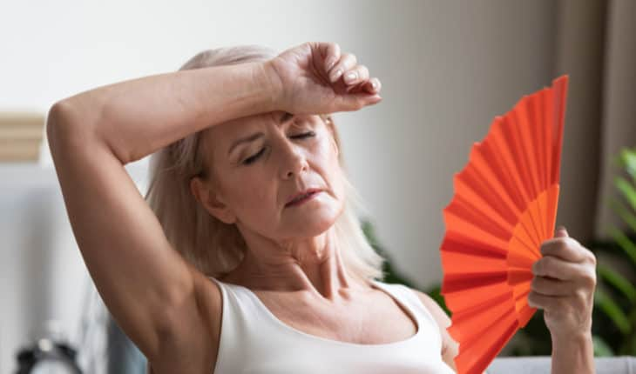
Menopause
Up to 75 % of menopausal women suffer from hot flashes
It is a result of reduction of hormones
Hot flashes are know to disrupt sleep patterns

Slide 29
Menopause
Treatment of hot flashes may help improve sleep
May lead to increased risk for obstructive sleep apnea

Slide 30
Advanced Sleep Phase Syndrome
Habitual and involuntary sleep onset and wake up times several hours earlier to conventional or desired sleep times.
Typically fall asleep between 6-9pm and wake up between 2-5am
Exact etiology is unknown
Considered a “lark”

Slide 31
Advanced Sleep Phase Syndrome
Treatment includes bright light in the evening to help delay the sleep time
Maintaining a steady sleep wake schedule

Slide 32
Improve Your Sleep
Keep a regular schedule
Morning light (VERY IMPORTANT)
Winter (broad spectrum light bulbs)
Morning exercise
Avoid green tea in the afternoon/evening
Avoid alcohol close to bedtime
Avoid napping

Slide 33
Restless Leg Syndrome

Slide 34
Restless Leg Syndrome (RLS)
Occurs in healthy people NOT related to emotional or mental conditions
Usually affects legs; also arms and body
“worms crawl under my skin if I don’t keep moving my legs”
“my legs decide they want to run, and I have to follow”

Slide 35
RLS
Can lead to insomnia
Signs/Symptoms for RLS
Usually worse at evening/night
Urge to move the legs
Temporary relief with movement
Uncomfortable sensation in legs (arms/body)

Slide 36
Causes of RLS
Genetics
Iron deficiency (<75 ng/ml)
Kidney disorders (hemodialysis)
Alcoholism
B12 deficiency, folate deficiency
Pregnancy (resolves with delivery)

Slide 37
Medications that Cause RLS
Antihistamine (Benadryl)
Antiemetics (Compazine, Reglan, Dramamine)
Lithium
Calcium Channel Blockers (Verapamil, Diltiazem, Nifedipine)
Major Tranqilizers (Haldol, Thorazine)

Slide 38
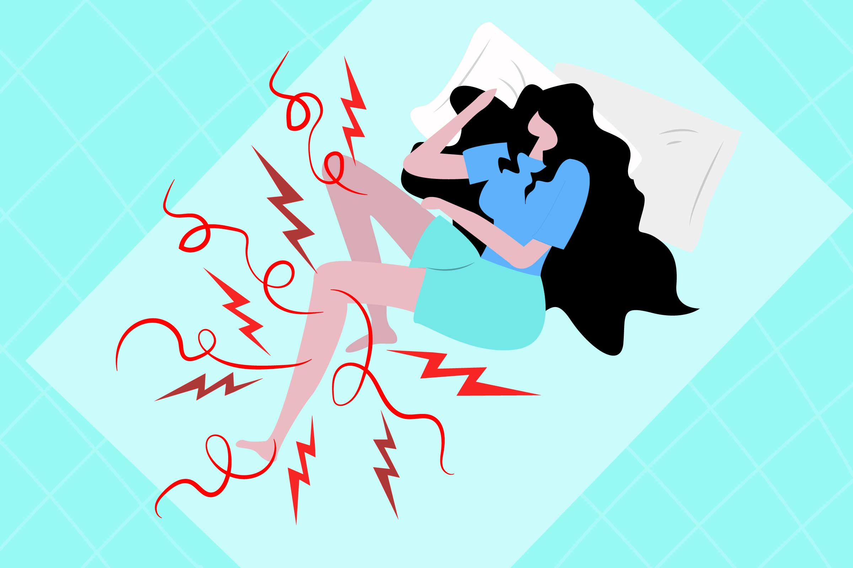
Diagnosis of RLS
See your doctor
Have blood work done
Review medication list

Slide 39
Treatment for RLS
Hot baths, leg massage, applied heat, ice
Dopamine agonist (Mirapex, Requip, Sinemet)
Benzodiaepine (Valium, Restoril)
Anticonvulsants (Neurontin)
Opioid (Codeine, Oxycodone, Methadone)
Clonidine

Slide 40
Jet Lag (Circadian Rhythm Disorder)

Slide 41
Jet Lag
Associated with rapid, long haul flights across several time zones
Associated with sleep disturbance, daytime fatigue, reduce performance, GI discomfort and general malise
Caused by desynchronization between body rhythms and environmental rhythms

Slide 42
Jet Lag to Paris
AIR FRANCE (to Paris)
Seattle Departure: 1:00 PM
Paris Arrival next day 8:15 AM (stay up and maintain bright sunlight)
AIR FRANCE (back to Seattle)
Paris Departure 10:10 AM
Seattle Arrival 12:10 PM

Slide 43
Treatment for Jet Lag with Melatonin (1-3mg)
Direction of Travel | During Travel | 1st Evening at Destination
Eastward Seattle to Paris | After it get dark, 30 minutes before target bedtime | After dark, 30 minutes before local bedtime
Westward Paris to Seattle | Not needed | After dark, 30 minutes before local bedtime

Slide 44
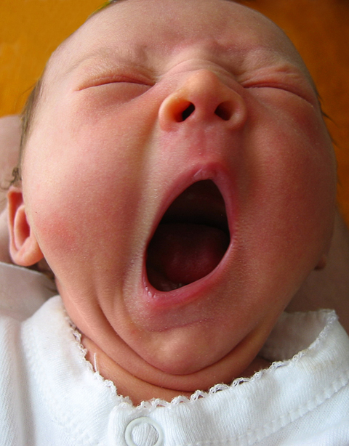

Slide 45
What is Obstructive Sleep Apnea?
Pauses in breathing or shallow breathing while you sleep
Pauses can last from seconds to minutes
Can occur 5 to 30 times or more an hour
Blockage of the upper airway by the throat muscles
Leads to disrupted sleep with daytime consequences

Slide 46
Central vs Obstructive Sleep Apnea
Obstructive
Mechanical obstruction of the airway
Central
Unstable ventilation control system
Heart failure
Medications (narcotics)
High altitudes (Everest, Machu Picchu)

Slide 47
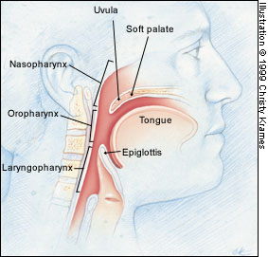
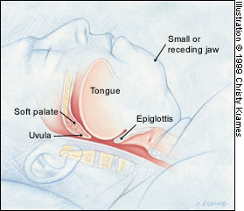
Obstructive Sleep Apnea

Slide 48
Who is at Risk for Sleep Apnea?
39 million American are at risk
More common in men and as we get older
Women are more likely to develop sleep apnea after menopause
Family history of sleep apnea
Obesity is a major risk factor

Slide 49
Signs and Symptoms of Sleep Apnea
Loud snoring
Choking or gasping may follow pauses
Not everyone who snores has sleep apnea
Morning headache
Memory issues
Irritable, depressed or mood swings
Urination at night
Dry throat

Slide 50
Signs and Symptoms of Sleep Apnea
Drowsy driving
Napping/dozing during the day
Feeling sleepy/tired during the day
Teeth grinding (bruxism)
Neck size:
>/=18 inches for men
>/=16 inches for women

Slide 51
Complications of Untreated Sleep Apnea
Hypertension
Diabetes
Stroke
Heart Disease
Atrial Fibrillation

Slide 52
How to Diagnose Sleep Apnea?
Consultation with a sleep specialist
Referral from your primary care doctor maybe necessary
Possibly undergoing an overnight sleep test
Assess brain waves, EKG, oxygenation in blood stream and other parameters

Slide 53
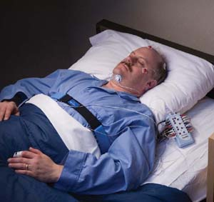
Overnight Sleep Test

Slide 54
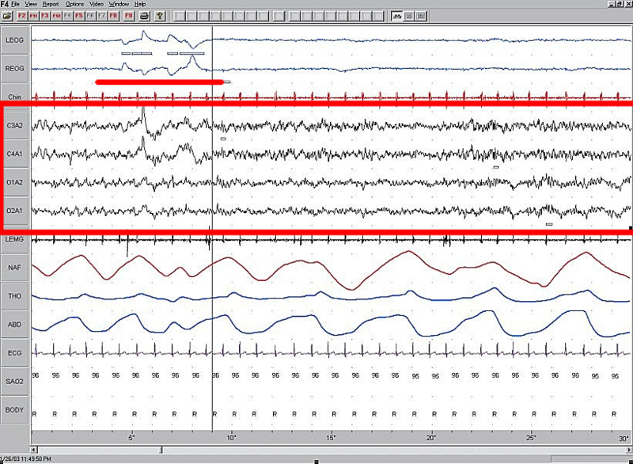

Slide 55
Goals of Treatment
Restore regular breathing during sleep
Relieve symptoms of snoring and daytime sleepiness
Improve sleep quality
Improve quality of life

Slide 56
Treatment for Sleep Apnea
Weight loss
Sleep on side/Head elevated
Dental Device
Surgery
CPAP (continuous positive airway pressure)
Inspire

Slide 57
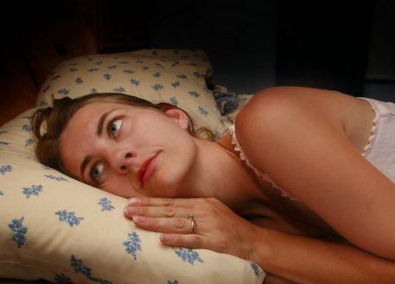
Insomnia

Slide 58
Insomnia
Defined as having trouble falling asleep or staying asleep.
Acute insomnia: < 1 month
Chronic insomnia:
>/= 3 nights/wk
>/= 1 month

Slide 59
Insomnia
Causes of insomnia:
Illness
Anxiety and depression
Medications
Caffeine, tobacco and alcohol intake
Poor sleep environment/routine

Slide 60
Insomnia
Causes of insomnia (continued)
Related to stress or being emotionally upset
Related to travel (jet lag)
Shift work
Pain (muscles/joints)
Restless leg syndrome

Slide 61
How to Treat Insomnia
Lifestyle changes
Avoid caffeine, tobacco close to bedtime
Avoid alcohol before bedtime
One alcoholic beverage allow 3 hours before bedtime
2 alcoholic beverages allow 5 hours before bedtime

Slide 62
Good Bedtime Habits
Follow similar routine every night
Going to bed around same time every night
No heavy exercise, heavy meals or alcohol too close to bed time
Minimize distractions in the bed room (computer, tv, telephone calls)

Slide 63
Medications for Insomnia
Herbs
Kava/L-tryptophan/Valerian extract
CBD products
Over the counter medications
Diphenhydramine
(Benadryl/Advil PM/Tylenol PM)
Melatonin

Slide 64
Medications for Sleep
Trazodone (Desyrel)
Zolpidem (Ambien/Ambien CR)
Zaleplon (Sonata)
Temazepam (Restoril)
Triazolam (Halcion)
Flurazepam (Dalmane)
Amitriptyline
Ramelteon (Rozerem)

Slide 65
Medications for Insomnia
Talk with your doctor
All medications may have SIDE EFFECTS
Follow instructions on medication labels
DO NOT mix sleep aides without knowledge of your physician

Slide 66
Cognitive Behavioral Therapy
Sleep Hygiene
Sleep Restriction
Behavioral Therapy
In some research studies, more effective that medications

Slide 67
Healthy Sleep Tips
Maintain a regular bed/wake time schedule including weekends
Establish a regular, relaxing bedtime routine such as a shower, reading a book or listening to music
Create a sleep-conducive environment that is dark, quiet, comfortable and cool

Slide 68
Healthy Sleep Tips
Use bedroom for sleep only
Finish eating at least 2-3 hours before bedtime
Exercise regularly. It is best to complete workout at least 2-3 hours before bedtime
Avoid caffeine (coffee, green tea, chocolate) close to bedtime

Slide 69
Healthy Sleep Tips
Comfortable mattress and pillow
Avoid smoking before bedtime
Avoid alcohol before bedtime
MORNING LIGHT
MORNING LIGHT
MORNING LIGHT

Slide 70
Acknowledgements
American Academy of Sleep Medicine website
American Academy of Family Medicine website
UpToDate.com
Garfield cartoon

Slide 71
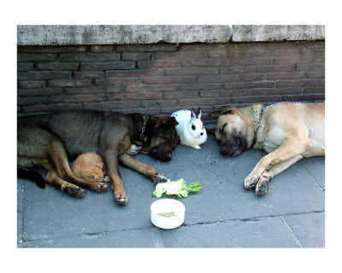
THANK YOU

